Slide 1

Vet Center Dashboard
Usability Study
Research Readout | December 3, 2021
Sitewide CMS team
Erika Washburn | Rachel Kauff | Suzanne Gray
Notes:
Hello and welcome to the readout for the Vet Center dashboard usability study! My name is Suzanne Gray, I’m a content strategist with the Sitewide CMS team. I’m joined by my colleague Erika Washburn, also a content strategist, who you’ll hear from in a little bit. The third researcher on this project was Rachel Kauff, our UX lead, who couldn’t be here today because she’s on leave.
We really enjoyed talking to the people who are using the CMS in real life, and we’re excited to share what we’ve learned. Thank you all for joining us today!
We really enjoyed talking to the people who are using the CMS in real life, and we’re excited to share what we’ve learned. Thank you all for joining us today!

Slide 2
Background & Goals
Notes:
We’ll start by talking about the goals of the study, share our findings and recommendations, and then share some additional insights that went beyond the scope of our original research plan.
We’ll have lots of time for questions at the end, so please save those up for us!

Slide 3
Background
The Sitewide CMS team designed and implemented a dashboard for Vet Centers in Q1 2021.The design intent was to:
Provide access to everything a Vet Center editor might need to do in one place.
Help Vet Center editors orient to their top tasks through cards that use icons and descriptions.
Bridge the gap between the content model and users' mental model through action links in cards that jump link to relevant parts of a form.
Allow editors to review satellite locations and their operating statuses at a glance so they can see what might need updating.
Notes:
The Sitewide CMS team designed and implemented a dashboard for Vet Center editors early in 2021.
The Vet Center websites are primarily edited by outreach specialists who have little technical background or experience creating content. And the form that editors use to enter content in the CMS is pretty complex. The dashboard was designed to make interacting with the CMS easier. It’s the first thing Vet Center editors see after they log in, and it provides access to everything a Vet Center editor might need to do right on one screen.

Slide 4
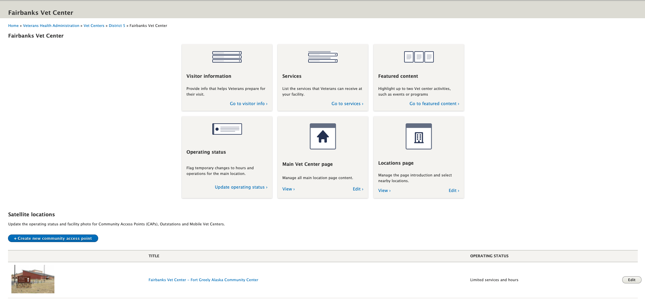
The Dashboard
Top Task Cards
Satellite Location Section
Notes:
Here’s what the dashboard looks like. Note that it’s not a traditional dashboard that shows you the status of particular things on your site. Rather, it’s a way of displaying jump links that take you to useful places in the form. Plus there are links to the main page and locations page forms. And at the bottom is a section that shows satellite locations.

Slide 5
Purpose
This user study supports OCTO-DE objective #3:
Increase the quality and reliability of VA services.
Less likely to make errors
Less likely to make errors
… which yields higher quality content for Veterans on VA.gov
When editors can easily find and edit their content, they’re ...
More likely to follow Veteran- centered content guidelines
Notes:
Just to orient ourselves to the bigger picture, this study supports OCTO-DE’s objective to “increase the quality and reliability of VA services.”
Our guiding principle is that when editors can easily find and edit their content in the CMS, they’re less likely to make errors and more likely to follow Veteran- centered content guidelines, which results in higher quality content for Veterans who visit VA.gov.

Slide 6
Study Goals
Goal #1
Goal #2
Validate design ideas to inform upcoming work on a VAMC product dashboard.
Generate recommendations for improving the Vet Center editorial experience.
Notes:
That’s the big picture of why we did this user study. More specifically, we had two goals. One was to validate the design ideas behind the dashboard, to inform upcoming work on a VAMC dashboard. Let’s make sure dashboards work before we start using them in other places.
The second goal was to generate recommendations for improving the Vet Center editorial experience.
Our research plan was very granular and focused on the dashboard functionality. But we quickly found that you can’t talk dashboard without talking about how you navigate within the CMS, and the types of content you can create, and more. So we’ll be sharing more about that during this presentation, too.

Slide 7
Hypotheses
The dashboard covers editor’s main tasks
The dashboard helps bridge the gap between editor’s mental model of the website and the content model
1
3
2
The dashboard makes it easier for editors to do their work, but may not account for all workflows
4
The Vet Center dashboard is a useful model for organizing editor workflow for other products
Notes:
Going into the study, our basic hypothesis was: the dashboard works and is a useful model for organizing the editorial workflow. And it could probably be improved.

Slide 8
Research questions
Does orienting editors with “top tasks” align with how editors actually work?
Does the dashboard help editors bridge the gap between how the content model structures information, and their own mental model for their site's content?
Do the cards help editors understand where their content will end up on the website?
Once editors have saved changes to content, how do they get back to the Vet Center dashboard to find other tasks?
Is the satellite location operating status dashboard useful?
Notes:
We wanted to know: does the dashboard work? Does it make life easier for non-technical editors, especially those who don’t use the CMS very often?
We were interested to know whether the tasks on the cards aligned with how editors actually work; whether editors understand where their content will actually end up on the site; and whether and how editors use the dashboard to move through their work.
Now I’ll pass it to Erika to talk about our methods and the types of people we talked with.

Slide 9
Methodology

Slide 10
Method
We conducted remote interviews via Zoom during October 2021.
We spoke with Vet Center editors from District 5 who:
Were not involved in the initial MVP user study
Were already familiar with working in the CMS
Work on a Vet Center site that had recently launched or was about to launch
We tested the usability of the dashboard and conducted a semi-structured interview about their top tasks.
During the testing process we asked editors to use the dashboard to walk us through their editorial workflow process.
Notes:
The study was conducted using a semi-structured interview process via Zoom in October 2021. Our process focused on editors' use of the dashboard to complete a series of exercises related to their editorial workflow process and related top tasks.

Slide 11
Participants
Vet Centers dashboard usability study
“I like being out in the community and meeting face-to-face with folks.”
5 editors, including Veteran Outreach Specialists and other supporting staff
Worked at the VA for 4-17 years
3 were former service members
Favorite part of job: working one-on-one with Veterans
Notes:
We interviewed 5 editors that included Veteran Outreach Specialists and other supporting staff. They have worked for the VA between 4 and 17 years and 3 were former service members themselves. Across the board, every editor said their favorite part of the job is working with the veterans one on one.

Slide 12

User context quotes
"I have a hard time with being on the computer. I like being out there with Veterans and helping them access resources."
"I'm not 100% fully comfortable with this thing." (the CMS)
"Working with Veterans is the easy part. Other things can be complicated."
"In the beginning I had fears that I was going to mess something up. I had never done this kind of work before. There's definitely some fear in there."
Notes:
Here are some of the most telling quotes from our study regarding how they were feeling about the process overall. Editors were willing to give their honest opinions and provided some unique and candid insights to how they feel

Slide 13
User context
Vet Center editors are great at engaging with Vets in person
Outreach is what they see as their job. Building the website feels “extra.”
4 of 5 participants have little experience with websites or with content creation, and describe themselves as “not tech savvy.”
They want to “get in and get out" of the CMS.
Notes:
It is also important to understand some baseline information about the editors that we spoke with. During the interview process, editors were forthcoming with their opinions about a variety of things. We were able to summarize some of the things they mentioned as insights here and this information comes straight from the thoughts shared with our team, and observations during the usability test. This sample of editors expressed that the website feels like something extra they have to do. Also, most described themselves as not “computer people” and this was all new to them. And when it comes to the work they have to do in the CMS, they prefer to just get in and get out of the system. Although this might not be the case for every editor in our system, we think it is important to recognize those that aren’t as comfortable with the CMS. Designing for them will help make the site easier to use for everyone.

Slide 14
Key Research Findings
Notes:
Now for the fun part. We had four key findings from the research.

Slide 15
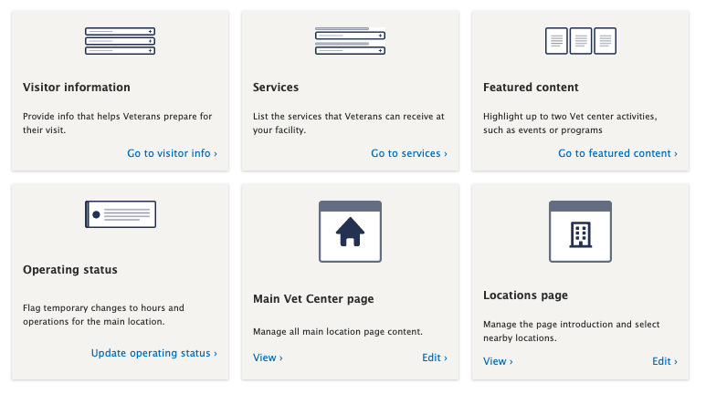
Dashboard cards work (but could be improved)
"This is the content of the main pages. I use this to go to every page."
“I just want it as basic as possible.”
Notes:
Overall, people understand the dashboard and its relationship to the form. They use it easily and seem to understand the overall concept..
One thing that was a little confusing for folks was the way the cards are arranged. No one really understood why they’re in this order. The cards for jump-linking to form sections aren’t easily distinguishable from cards for the entire form -- like the main page and location page links. This makes it a little harder to understand how the dashboard relates to the form. Two of the editors preferred to do all their work on the main page without using the dashboard jump links, for them, it would be easier if the main page link were easier to find.

Slide 16

Dashboard cards work (but could be improved)
This confirms that the dashboards are an effective tool for helping editors work on their sites.
Participants used the dashboard with ease, and understood the relationship between the cards and the form.
There was some confusion about the order of the cards. Cards for form sections aren’t easily distinguishable from cards for pages.
Slow page load on the form means the jump link functionality doesn’t work smoothly in practice.
Notes:
FInally, we also observed that when editors clicked on a card, it took a couple of seconds for the page to load, because of the link reports at the top, and in that time some editors would get disoriented and scroll all through the form looking for the right section. So, in practice the jump-linking can be a bit of a challenge for some people.
But overall, the takeaway here is that dashboards are an effective tool for helping editors work on their sites

Slide 17
Keep the dashboard; iterate the design
Recommendation
Explore reordering the dashboard cards for ease of use.
Consider separating "Main Page" and section jump links.
Consider surfacing the operating status for greater visibility.
Remove the node link report from the edit page for faster page load.
Notes:
Based on this research, our recommendation is to keep the dashboard concept and iterate on the design. We can explore reordering the dashboard cards for ease of use, possibly by separating "Main Page" and section jump links. We could consider surfacing the operating status on the dashboard for greater visibility-- more on this later. And to make the jump linking more seamless, we could remove the node link report from the edit page for faster page load.

Slide 18
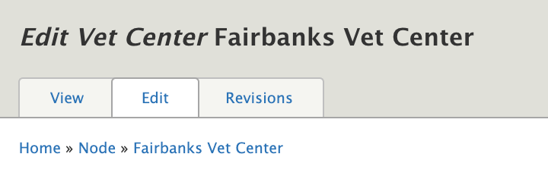
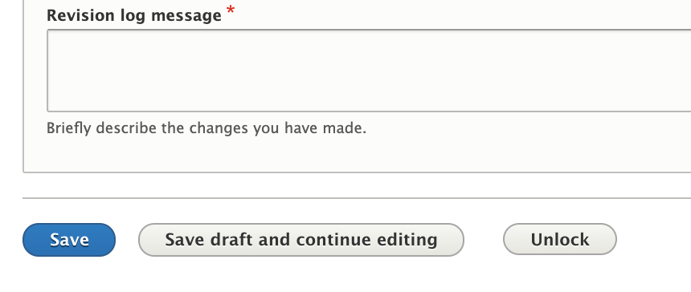
2. The content workflow is unclear
“It is confusing to see how [my content] got added.”
“I wanted to go back and was confused.”
“Is it ok to just go to home?”
Notes:
We asked editors to do several tasks that involved adding various types of content, like featured content or a new service. What we observed was that the content workflow is unclear. Getting into the form works fine-- but what happens once you’re done writing your content is pretty murky.
Returning to the dashboard from inside the form was a challenge for every single participant. If you save your work, you’re automatically taken back to the dashboard. But if you don’t save, there’s no clear path to get back. They all had different ways of doing it. Some used the back button, some tried to use the breadcrumbs (which don’t actually include the dashboard), and some ended up in the drupal content menu and requested our help to extricate themselves.

Slide 19
2. Content workflow is unclear
Without a clear path for previewing content, editors may be disinclined to check their work, resulting in lower-quality content.
Poor navigation requires more time and mental overhead, which adds to editors’ frustration with the CMS.
Participants were unsure of how to preview their work.
There was no clear path to return to the dashboard. No user returned to the dashboard the same way.
Notes:
Another workflow issue stems from saving and previewing work. When you save, you go back to the dashboard. But how do you then check the work you just did? Again, there’s no clear path to preview your work or changes made to the page. There is a preview button inside the main form view, but participants weren’t confident on where to find it or what’s the best practice for previewing any changes.
Both of these issues present a risk of lowering the quality of content on VA.gov. Without an intuitive way to preview content, editors may be disinclined to check their work, which could easily result in errors being published. The challenge around navigating back to the dashboard requires editors to spend more time and more mental overhead figuring out where to go. That adds to editors’ frustration with the CMS, makes them not want to be in there, which ultimately leads to worse content as well.

Slide 20
Clarify content workflow
Recommendation
Create a clear path for users to return to main dashboard from edit page.
Consider accurate breadcrumbs or return to dashboard button
Build an intuitive way to preview saved content
Consider a preview button near the editorial workflow and/or on the dashboard.
Consider how best to draw attention to new content
Notes:
From our research we would suggest creating clear paths for users to return to the main dashboard from the edit page. This could include accurate breadcrumbs or a return to dashboard button. There should also be a more intuitive way to preview content after saving. These options could include a preview button near the editorial workflow and/or on the dashboard. Also, more thought should be given to how best to draw attention to new or recently edited content.

Slide 21
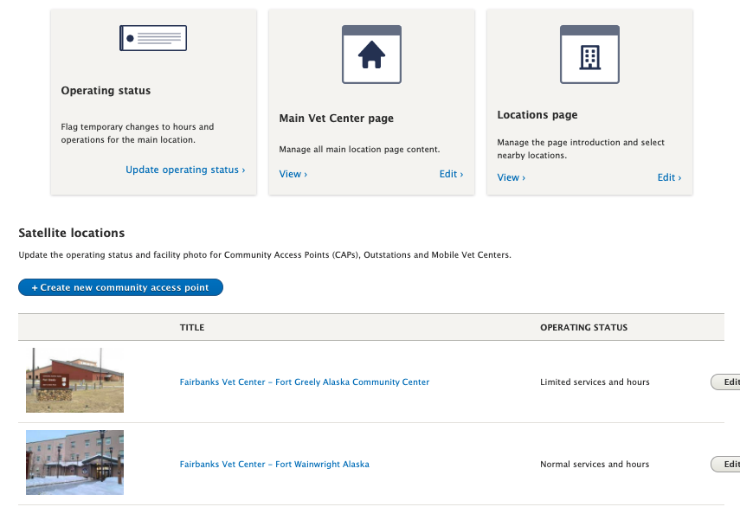
3. Operating status & satellite locations are a mysterious tangle
“I feel like it should be from a higher authorization to actually close the Vet Center”
Notes:
We asked editors to complete tasks like updating the operating status and adding a satellite location. But the results were inconclusive. None of them had ever had to update the operating status before. They found the dashboard card easily enough, but from there they struggled to complete the task. Two editors weren’t sure if they even had the authority to change an operating status.
The satellite location part of the dashboard is one place that does surface the operating status. This is a bit confusing: the UI is trying to solve two problems at once. But combining the two confuses the workflow for both.

Slide 22
3. Operating status & satellite locations are a mysterious tangle
The operating status is critical info for a Veteran planning a visit. If it’s not accurate, Vets will lose trust in the VA.
Users lack clarity about what the operating status is, why it merits special attention, and what to do with it.
None of the editors had experience with changing the operating status, and most had not used satellite locations.
They weren’t sure if they had permission to make changes.
Notes:
This matters because operating status is critical information, and it’s rarely changed. Which means that the guidance needs to be extra clear so that editors get it right. Editors need to understand how operating status changes are authorized internally, and the exact process to make updates within the CMS. Bottom line, if the operating status isn’t accurate there is a risk that Vets will act on bad information and then lose trust in the VA.

Slide 23
Offer clear guidance & keep testing
Recommendation
Provide clear guidance about how and when to update the operating status
Surface operating status for all locations in one widget on the dashboard
Do more user testing around operating status and satellite locations as people use the features more
Notes:
How do we do that? We recommend providing clear guidance to editors on how and when they update their operating status. We can explore creating a dashboard widget that surface operating status for all locations so that editors can easily see and update them. And importantly, we recommend doing more testing around both operating status and satellite locations as editors get more experience with maintaining their sites.

Slide 24
Summary of Findings
Does orienting editors with “top tasks” align with how they actually work? | YES
Does the dashboard help editors bridge the gap between how the content model structures information, and their own mental model for their site's content? | Sort of
Do the cards help editors understand where their content will end up on the website? | YES
Once editors have saved changes to content, how do they get back to the Vet Center dashboard to find other tasks? | It varies
Is the satellite location operating status dashboard useful? | Not yet
Notes:
So wrapping up here with a return to our original research questions:
Does orienting editors with “top tasks” align with how they actually work? YES
Did the dashboard bridge the gap between how the content model structures information, and their own mental model for their site's content? Sort of. Users understand the relationship between the dashboard and the form, but are still confused by the difference between back end and front end content and appearance.
Do the cards help editors understand where their content will end up on the website? Yes. The labels seemed intuitive to people.
Once editors have saved changes to content, how do they get back to the Vet Center dashboard to find other tasks? It varies
Is the satellite location operating status dashboard useful? Not yet

Slide 25
Additional Insights
Notes:
As we mentioned, our participants were quite candid with us. While they were completing these usability tasks, they also shared a lot of thoughts and feelings about other aspects of the website and the content creation process. We recognize that these things are outside the scope of our research, but we thought it was important to share what we heard.

Slide 26
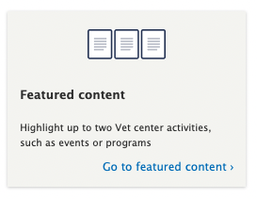
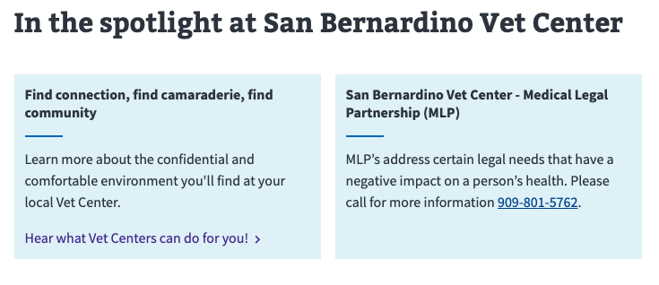
Featured content is high value; events can help long term
"Everything I do is right here. Community events and new services... Anything special that we offer, I just go to featured content."
Dashboard
Front End
"It’s really hard to fit everything into the field. I had to go back in a million times."
Notes:
Editors really value featured content as a way to customize their site and reflect the local activities that are at the heart of their work as outreach specialists.
But featured content is very limited. All the participants chafed against restrictive character limits, which they said prevented them from providing relevant info to Veterans. One participant said, "It’s really hard to fit everything into the field. I had to go back in a million times." Another said, “How can we feature our event if we can't add more words? I don't know why it limits us.”
Featured content is short for a reason -- but there is no other place for this info to live. Editors desperately need better functionality for promoting events.

Slide 27
Featured content is high value; events can help long term
Reaching out to Veterans is the heart of editors’ jobs, so the limitations of the featured content fields directly impede their work. As a result, editors feel like the website doesn’t serve their needs, and are disinclined to update content regularly.
Participants value the featured content section because it allows them some freedom to reflect local offerings, such as events.
However, they chafe against restrictive character limits, which prevent them from providing adequate info about special programs to Veterans.
Participants want better functionality for promoting events.
Notes:
This is really important because reaching out to Veterans is the heart of editors’ jobs, which means the limitations of the featured content fields directly impede their work. As a result, editors feel like the website doesn’t serve their needs, and are disinclined to update content regularly.

Slide 28
Build out events functionality
Recommendation
Create a robust event listing feature that allow editors the space they need to promote local activities
Short term: Consider how to enhance or possibly expand the featured content section to better serve local needs
Notes:
Based on this, we encourage the team to prioritize building events functionality, to allow editors the space they need to promote local activities. In the short term, we might also consider how to enhance or possibly expand the featured content section to better serve local needs.

Slide 29
2. There’s a disconnect around localized content
"I get it, it’s VA, everything has to be uniform, but the website is too basic."
"In reality, not one Vet Center is like the other...We’re all created equal but you evolve to meet the population you’re working with."
The point of the content creation process is to highlight local offerings, but editors feel that the system does not meet their needs.
This leaves editors feeling resentful, unseen, and resistant to the task of creating and maintaining their website content.
Notes:
Our next finding is that editors are struggling with the content process over all.
Read quote: "I get it, it’s VA, everything has to be uniform, but the website is too basic."
"In reality, not one Vet Center is like the other...We’re all created equal but you evolve to meet the population you’re working with."
All editors expressed how unique Vet Centers are and they are proud of the way they tailor their programs to those specific needs. While we know that editors are encouraged to make their websites personal, that does not seem to be their understanding in practice and possibly not enough for what they feel is proper localization. Therefore, there is a disconnect between the intention of the content process and what they can actually do.
From our research, we learned from most editors that they had some negative feelings associated with the lack of customization and their overwhelm of the overall transition to the digital landscape.
Just like with the first additional insight, many weren’t sure of the value that the website in general brings to their outreach duties. They said that it felt like an imposition rather than an extension of their jobs. They did not have enough context or understanding about the role that these job duties had to their mission. There were also feelings of overwhelm, confusion, and even feelings of being blindsided because they felt this project came out of the blue. This frustration was only compounded by the fact that these editors were not confident in their technical ability and felt their writing was not up to standard.

Slide 30

Reactions to the content creation process
“For people like me who aren’t website designers, it’s like doing homework. You get it back with red ink."
"It’s presented as if it’s easy [to update the site], but it’s not."
"It felt like I was getting a D in this class.”
"People on your end want to see more professional work."
"My biggest fear is that I am going to be grammar checked or scolded.”
Notes:
I’m going to read some of the thoughts shared directly from the editors and please keep in mind that the quotes are not from the same editor expressing one thought.
This has implications for the upcoming editor onboardings and, long term, the overall project of digital modernization. As explained before, these editors are not tech savvy and don’t feel comfortable doing the writing needed for website work. Therefore, asking them to do this has resulted in a huge lift for those editors that identify with those sentiments.

Slide 31
Iterate on Vet Center onboarding
Recommendation
For Vet Center websites to provide lasting value to Veterans, editors must be bought in.
This is an opportunity to emphasize the value of the website for supporting local outreach efforts.
More research around editors’ experiences may be beneficial.
Notes:
So what do we do with this information? As researchers that stumbled upon insights well outside of the scope of the intended research, we want to bring this to the larger group for ideas on how to approach this. From our observations, we have found that editors want to be of value to the Veterans they serve and their onboarding process can be a way to help firm up the MVP goal. We have the potential during their onboarding process to gain the buy-in that eliminates some of the more negative feelings about the website tasks in general.
The participants shared these messages of confusion and frustration with us during the course of their dashboard exercises and we believe this could be telling of what is to come as other districts onboard to the process. We all have a shared mission and editors are a big part of getting Vets in the door to get the services they need.
From a CMS perspective, we sense that there are some research opportunities here around onboarding editors and the change management that goes into that. However we agree to move forward, I implore you to think about this information in a timely manner because as we speak we have other districts coming into this process. There’s a really exciting opportunity here to bridge the gap between how editors feel about their new website duties, the amazing outreach opportunities that live there now and could live there, and how they interact with the CMS to do that.

Slide 32
Next Steps
Recommendation | Next Step
Iterate Vet Center dashboard design | Refine ACs for design ticket #6736
Clarify navigating to dashboard
Clarify workflows for previewing work
Ideate on VAMC dashboard | Start in Q1. #1447
More work on operating status | Updates on current tickets #6319 (field governance), #6816 (hours/op status)
Events functionality | TBD
Editor onboarding and change management | TBD
Notes:
Circling back to our recommendations about the dashboard, here’s what’s coming next.
The CMS team has a meeting next week to refine the ACs for ticket #6736 regarding the dashboard design and some of the workflow and previewing issues
Ideate on VAMC dashboard will start at Q1
More work on operating status - this research will inform immediate work on some tickets coming up
Events stuff - we know this is on Dave’s radar
Editor onboarding and change management - this is up to you all, we’re happy to help

Slide 33
Questions?
Suzanne Gray
Slack: @Suzanne Gray Email: suzanne.gray@civicactions.com
Erika Washburn Slack: @Erika Washburn
Email: erika@cityfriends.tech
Notes:
We know that this was a lot of information. Keep in mind that all feedback is a gift, and hearing directly from users is an important part of making our work better. At this time we’re happy to talk through any questions you may have.

